Slide 1

User Experience and User Interface Design
01: User Experience Design
Dr. Seyed Reza Shahamiri More Info

Slide 2

Link

Slide 3


What is User Experience (UX)?
3

Slide 4
What is User Experience (UX)?
4
User Experience (UX, UXD, UED or XD) is the study of users and their particular contexts in order to design tools so that users can perform tasks with the tools to achieve their goals.
According to Wikipedia:
“It is the process of enhancing user satisfaction with a product by improving the usability, accessibility, and pleasure provided in the interaction with the product. User experience design encompasses traditional human–computer interaction (HCI) design, and extends it by addressing all aspects of a product or service as perceived by users.”

Slide 5

What is User Experience (UX)?
5

Slide 6
What is User Experience (UX)?
6
UXD is about understanding the users and their context, rather than trying to impress them with visual flair.

Slide 7
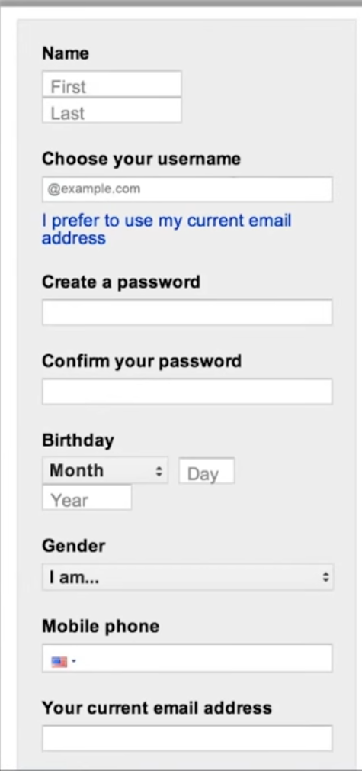
What is User Experience (UX)?
7
Look at this login form and think what would you do to improve its UX for an Android smartphone.

Slide 8

What is User Experience (UX)?
8

Slide 9
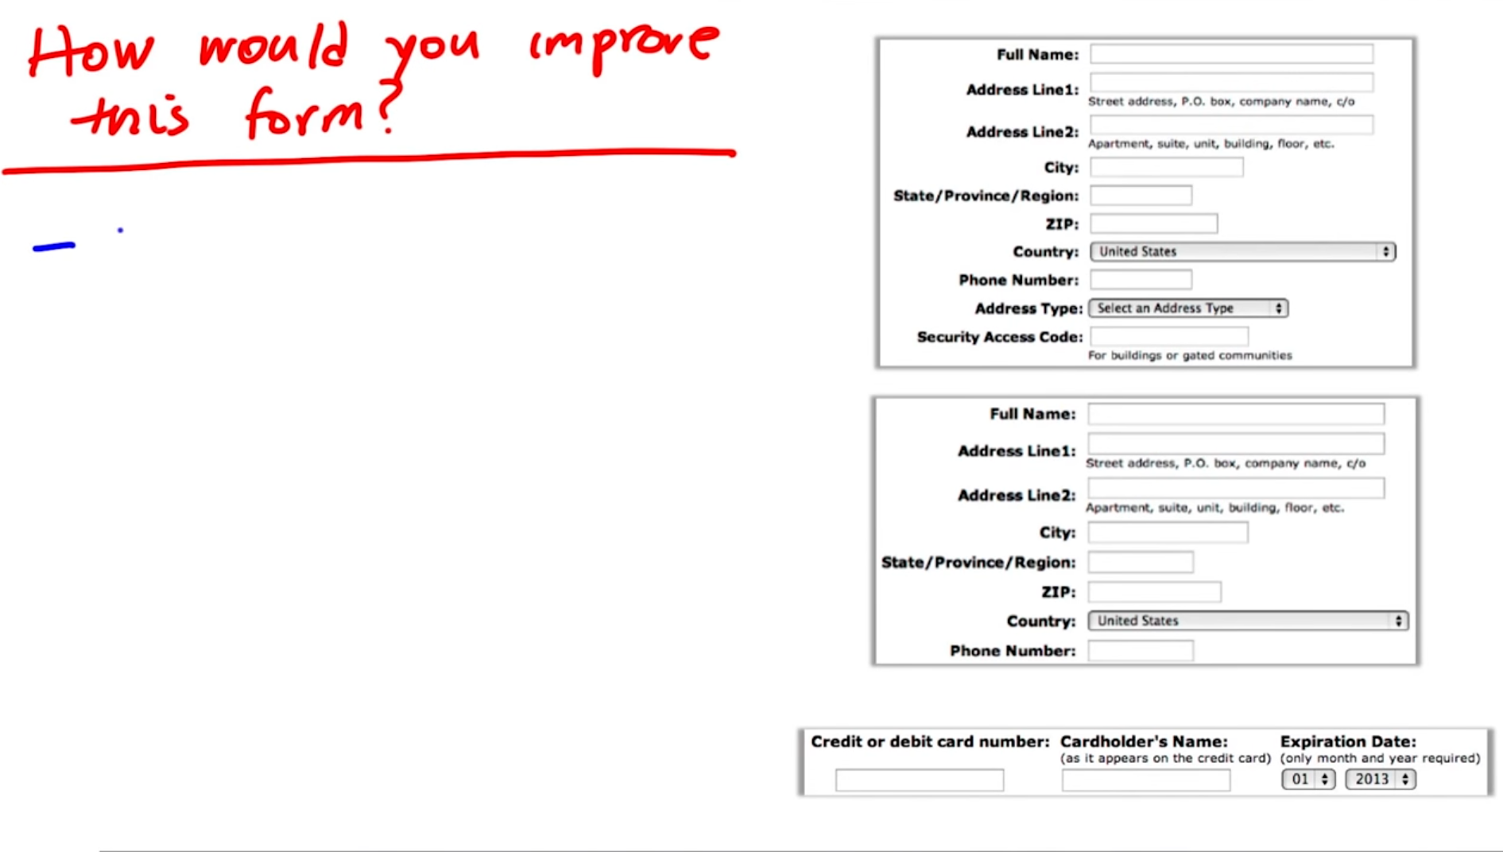
What is User Experience (UX)?
9

Slide 10
What is User Experience (UX)?
10
Suppose you re-designing a mobile app to sell cookies.
What are the steps that a user should take to purchase a cookie? Discuss this to provide a good user experience.
Notes:
User Signs in, select the cookie, purchase, and eat!

Slide 11
What is User Experience (UX)? Emphasis on improving usability
11
Software Usability is the degree to which a software can be used by specified consumers to achieve quantified objectives with effectiveness, efficiency, and satisfaction in a quantified context of use.
Usability is a method used to assess the quality of an interactive design.

Slide 12
What is User Experience (UX)? Emphasis on improving usability
12
There are five components of a usability test:
Learnability
Efficiency
Memorability
Errors
Satisfaction

Slide 13
What is User Experience (UX)? Emphasis on improving usability
13
Over 100 years ago, Henry Ford is reported to have said that if he asked customers what they wanted they would have replied ‘faster horses’. This quotation is sometimes used by those who question the idea of centring the design process on the user. When leaps in technology come along, such as the invention of the motor car and the production line, a ‘user’ is not in a position to conceive the potential impact on their experience. It is argued that users are inherently conservative and will often prefer a familiar design to a new and improved one.

Slide 14
What is User Experience (UX)? Emphasis on improving usability
14
Instead of asking what users want, we observe what their experience is and think of ways to improve it by using knowledge and skill.

Slide 15

What is User Experience (UX)? Emphasis on improving usability Example: Propellerhead
15

Slide 16

What are your favorite and unfavorite apps?
16

Slide 17
17
‘It’s not enough that we build products that function, that are understandable and usable, we also need to build products that bring joy and excitement, pleasure and fun, and yes, beauty to people’s lives.’
– Donald Norman

Slide 18

Additional Resources Link
18

Slide 19
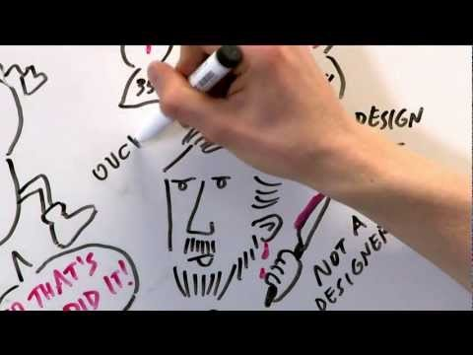
Additional Resources Link
19

